Slide 1
WHY WEATHER
#1 Pilot Killer
Know the least about it
The best sources of information are changing rapidly with Web based tools
You shouldn’t be surprised by what you see through the windscreen

Slide 2
Agenda
High and Low Pressure Systems
Long Range Wx models – GFS
Short Range Wx tools – HRRR & LAMP
Q & A

Slide 3
GFS Upgrade
8 Day to 10 day 3 hour fcast cycle
Higher resolution
  from 27km to 13km for first 10 days
  55km to 33km for day 11 thru 16
Improvements to algorithms and sampling
Higher computing power (2.5 petaflops)
New products – Hi-Res Rapid Refresh

Slide 4
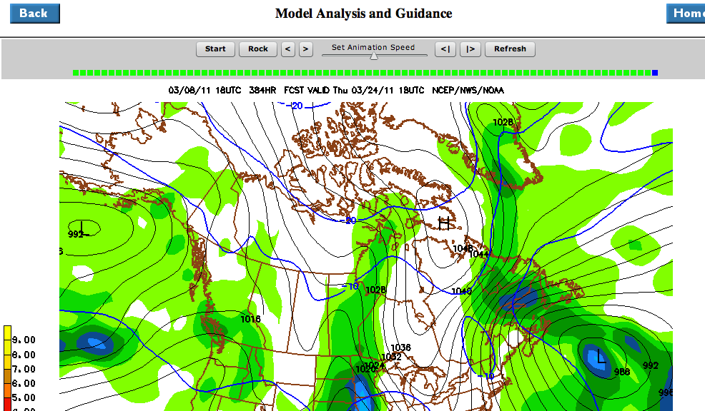
GFS – Global Forecast System
Runs 4 times per day
First 10 days – 3 hr windows
Second 6 days – 12 hr windows
13km (or33 km) grid by 64 levels
in atmosphere

Slide 5
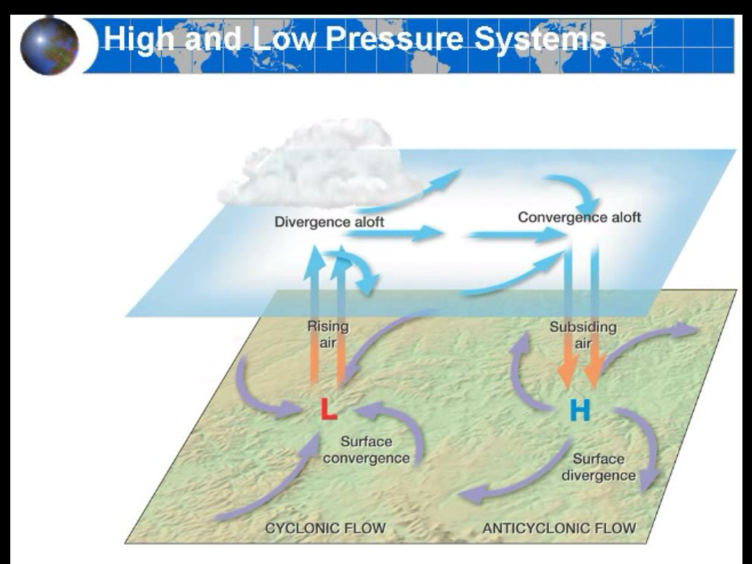
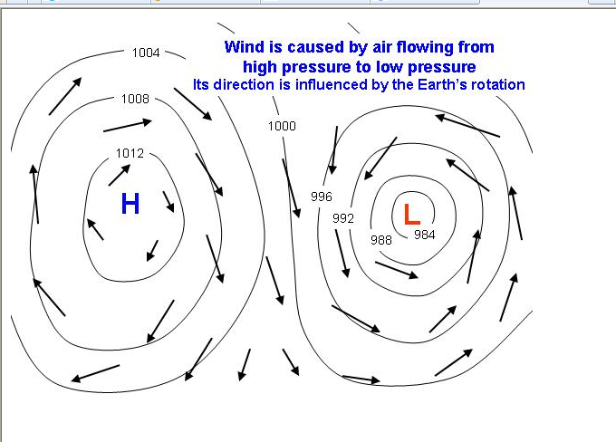
High and Low Pressure is
Caused by the uneven heating
Of the atmosphere

Slide 6
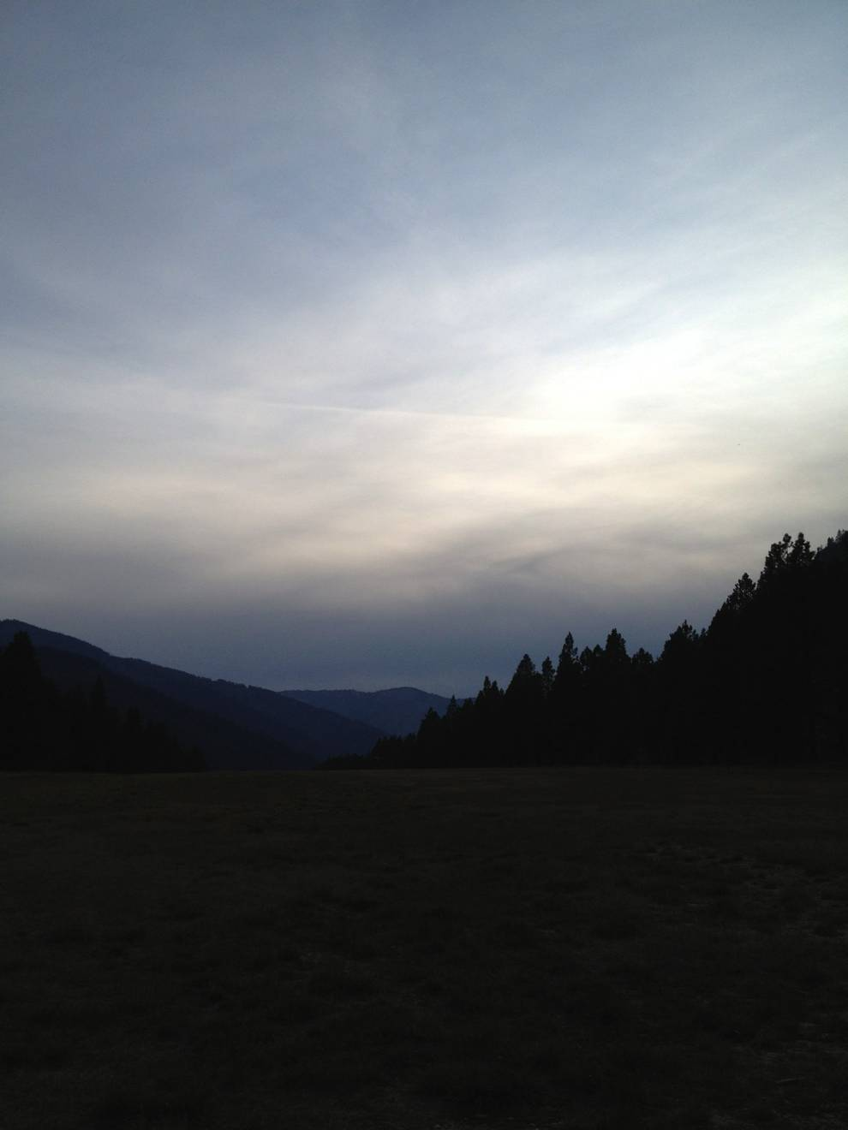
12 hours before incoming LOW

Slide 7
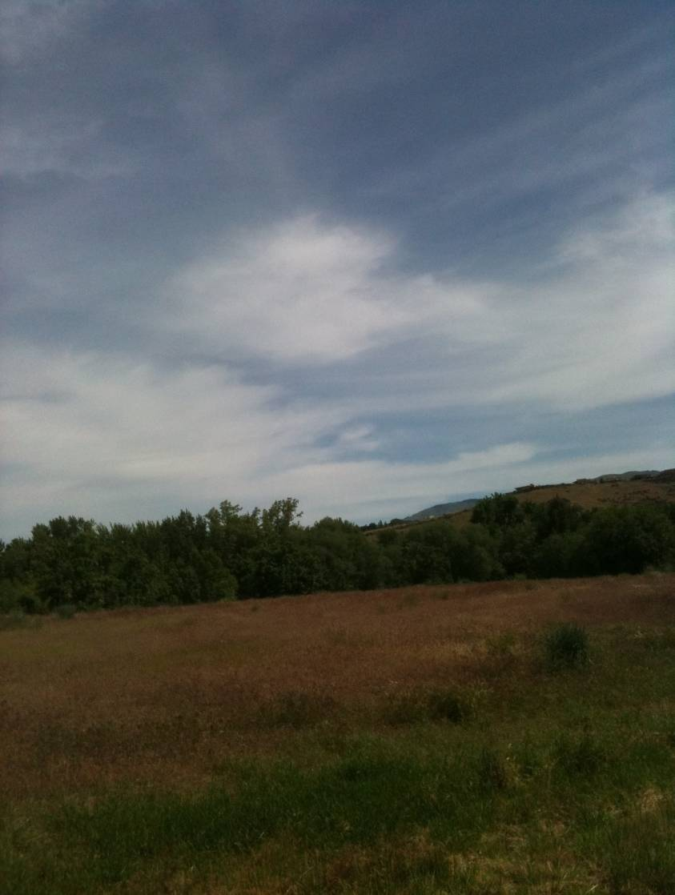
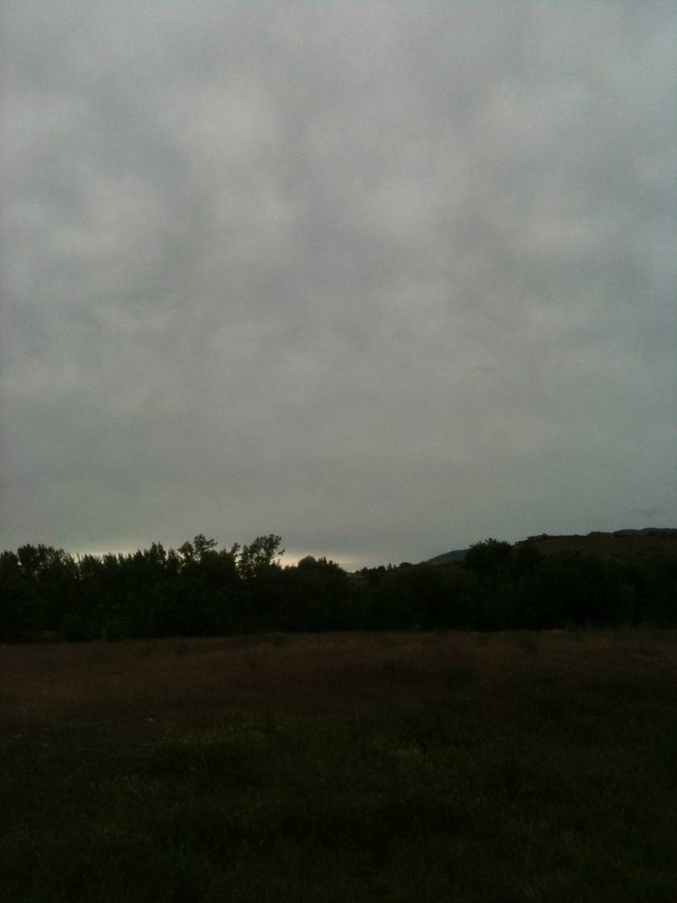
Incoming Low Pressure System
10am
6pm
(light rain 2 hours later

Slide 8
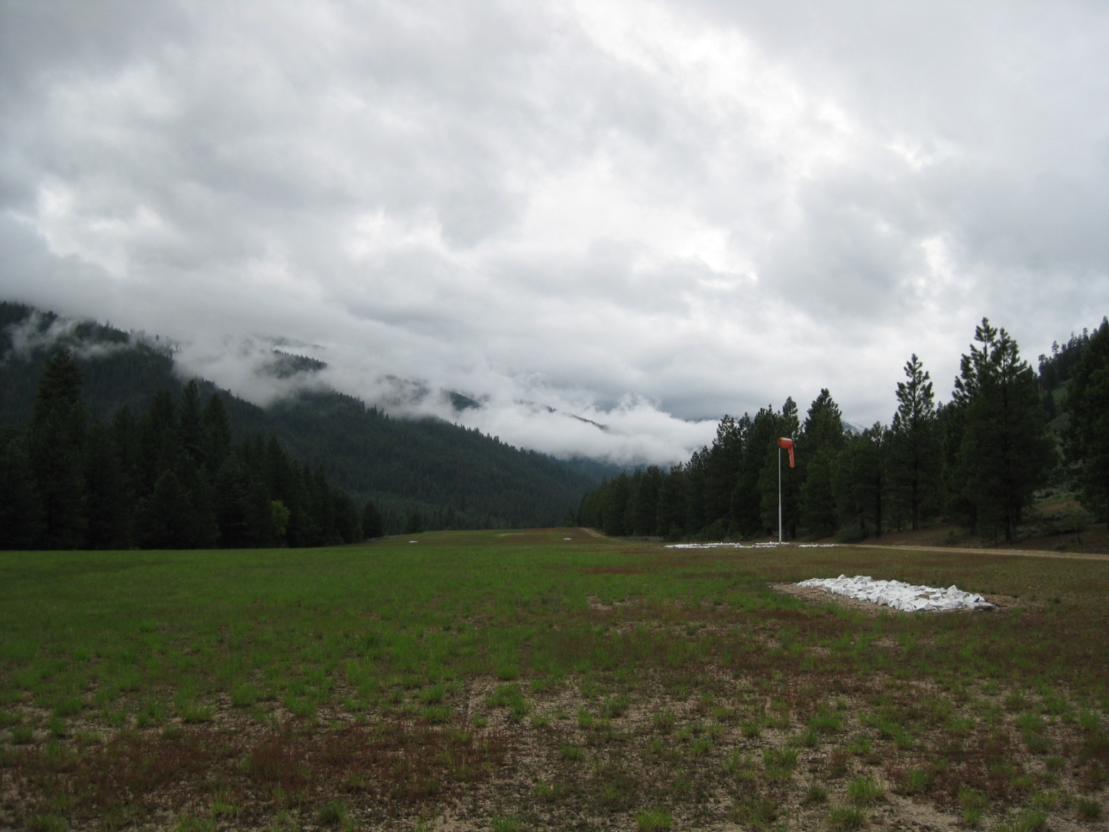
A Serious LOW

Slide 9
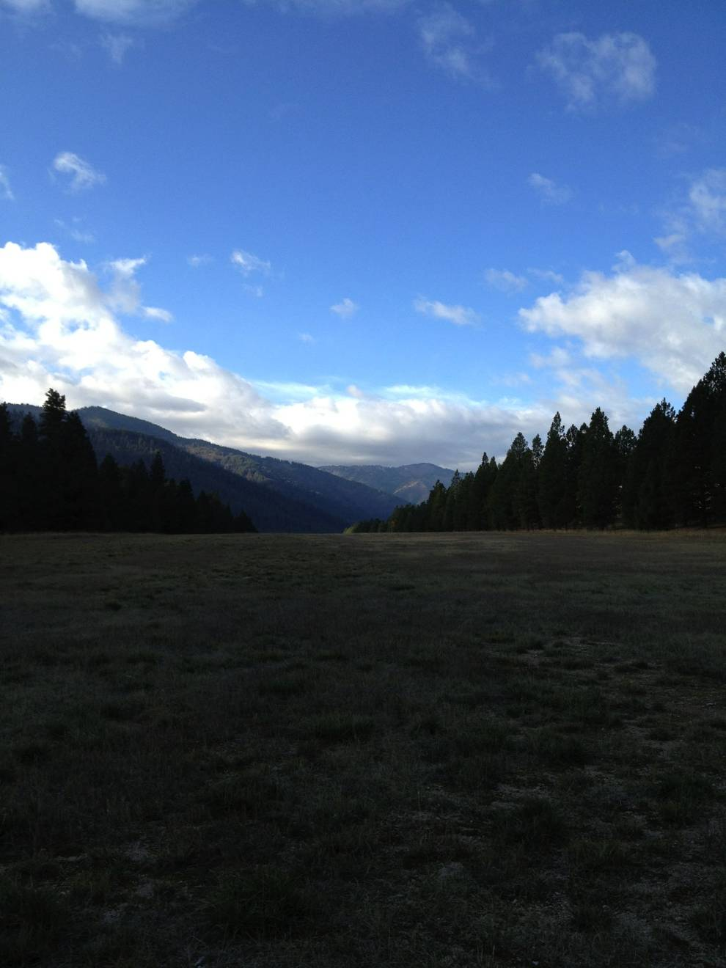
Debris Day

Slide 10
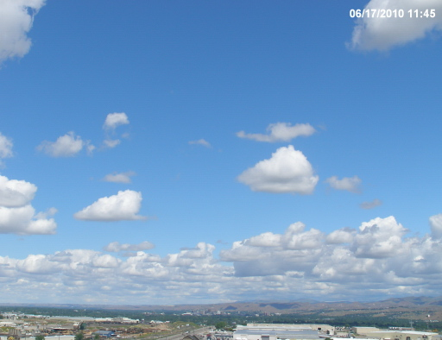
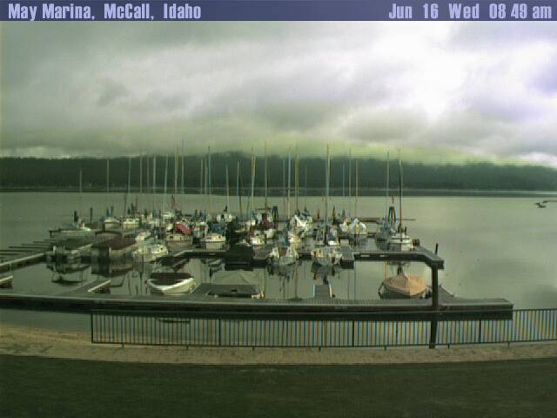
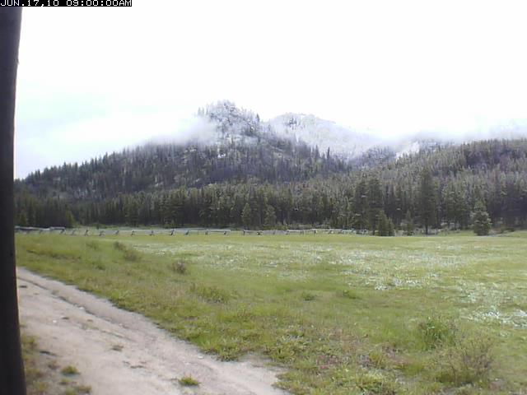
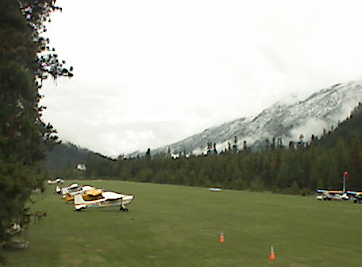
Valley vs Mountain Debris Day
http://www.cityofboise.org/Departments/Public_Works/Services/AirQuality/page10796.aspx
http://www.idahohotsprings.com/infocenter/webcams.htm
http://www.flyingresortranches.com/
http://www.pilotcams.org/northwest-us-webcams/48-smiley-creek-id-u87

Slide 11
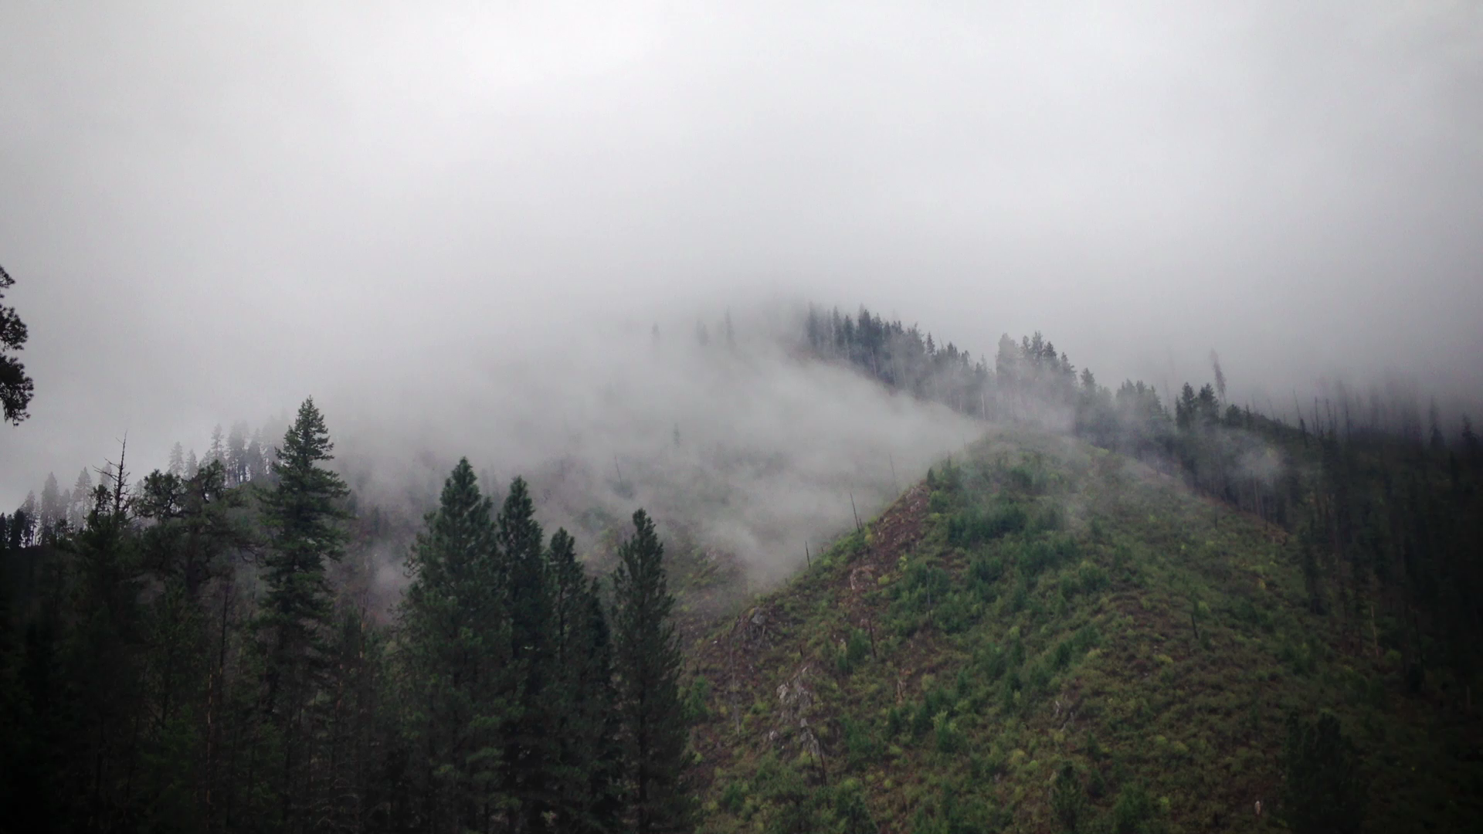
When temp and dewpoint meet…
Fog and low clouds are worse in canyons with trees – due to high RH

Slide 12

Want to Learn More…
www.avwxworkshops.com

