Slide 1
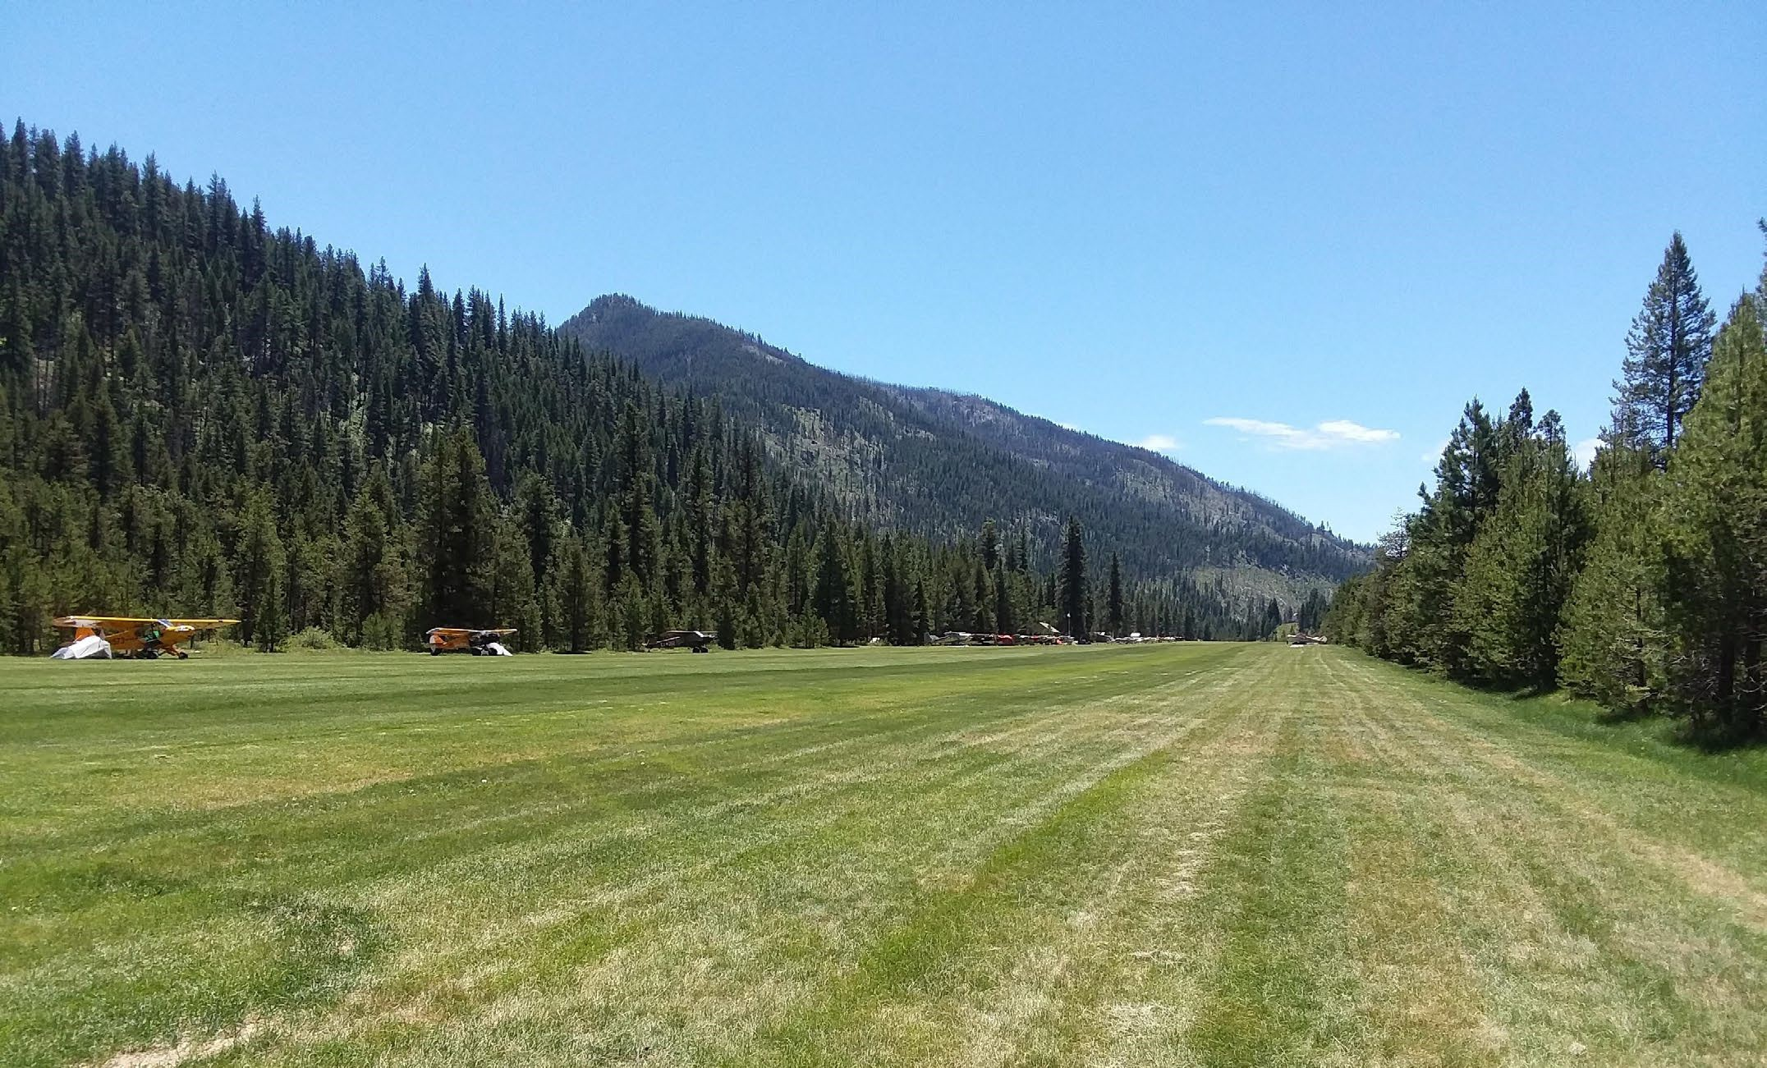

FY-23 Annual FSDO NM-11 Report
FY 2023
Boise Flight Standards District Office
A Review of Aviation Accidents
10 Year Data Period Beginning 10/01/2014 Ending 09/30/2023

Slide 2
Prepared by: The FAA Safety Team Brian Lord – FPM Airworthiness
TABLE OF CONTENTS
Introduction to the Annual FSDO Report Objective
Local Event / Trend Monitoring Data Collection
Data Analysis
U.S. National Accident Data Accident Totals FY2014-2023
National Fatal Accidents & Fatalities Boise Fatal Accidents & Fatalities
National Count of Accidents by Highest Injury
Boise Count of Accidents by Highest Injury Accident Causal Factors Nationwide Accident Causal Factors Boise
Phase of Flight
14 CFR 135 Accidents
14 CFR 137/ Public Use Accidents 14 CFR 91
Accidents by A/C Type (Rotorwing) Accidents by certification (Experimental) Accidents by Month of the Year
Pilot Domicile
Backcountry, Accidents & Fatal Accidents Incident Totals 2014-2023
3
3
3
3
4
5
5
5
6
7
8
9-10
11-12
13
14
14
15
16
16
17
18
19
20

Slide 3
Hazard Identification, Risk Assessment, Mitigation Strategies Hazards and Risks – General
Hazard Area 1: Pilot Decision Making Hazard Area 2: Preflight Preparation
Hazard Area 3: Experimental Amateur Built & Light Sport Aircraft Hazard Area 4: Backcountry Operations
Other Mitigation Activities SUMMARY
Appendix 1: Risk Matrix
Appendix 2: List of fatal accidents for the reporting period Appendix 3: FY 2023 Accident/Incident Data
21
21
21
22
23-24
24-25
25
25
26
27
28-29
Introduction to the Annual FSDO Report
The Federal Aviation Act of 1958 was signed into law to help regulate and promote the growth and development of U.S. aviation activities. To this day, the Federal Aviation Administration is commissioned to both monitor and promote aviation safety.
The FAASafety Team was founded in 2006 from an existing Safety Program first established around 1964. The FAASTeam goals are based on an organized business plan developed to assist the FAA in promoting safety, by identifying trends to help reduce aviation accidents and incidents. The FAASTeam Program Manager will present the FSDO Report to their respective FSDO Managers and offices on an annual basis.
Objective
The “Objective” of this plan is to support the goals of the FAA Flight Plan, and the National FAASTeam Performance Plan. Its purpose is to identify trends of unwanted events including aircraft accidents and incidents within the boundaries of the Boise Flight Standards District Office. An analysis of collected data is included, as well as strategies to mitigate the identified risk. The mitigation plan will allow for targeting event precursors and causal factors, as well as support the efficient use of limited resources within the district.

Slide 4
Local Event / Trend Monitoring
The Annual FSDO Report was designed to identify trends specific to each state and the local FSDO geographic boundaries. The report demonstrates that each area is unique to aviation activities and that safety results vary with the type of operation performed. The cause of accidents is also unique in that they may be contrary to national trends and statistical data.
This report takes into account all reported General Aviation accident events in the Boise (BOI) District Office area from FY2014 through FY2023. It identifies the several different types of operations in the Boise FSDO area.
Data Collection
The trends identified in this report are a result of a collection of data from a variety of sources. It includes a careful review of the FAA Inspector’s field reports (FAA Form 8020-23), FAA and NTSB and Incident Databases, and the FAA National Program Tracking and Reporting System (NPTRS).
Data Analysis
Reviewing all pertinent data from the sources included in the “Data Collection” paragraph above possible contributing factors were categorized into the following categories:
Loss of Control
(F) Event occurred during flight.
(G) Event occurred while taxiing after landing or prior to take-off.
(L) Event occurred during the landing sequence.
CFIT – Controlled Flight into Terrain
Engine Failure (Including Partial Loss of Engine Power)
Low Altitude Operations
Loss of power
Mismanaged systems
Fuel, whether starvation or exhaustion
System Component Failure (Aircraft Part Failed)
Mid-Air Collision
Weather related or was weather a contributing factor?
Other/Unknown
Pilot Domicile (Was the pilot based within FSDO boundaries?)
If Experimental

Slide 5
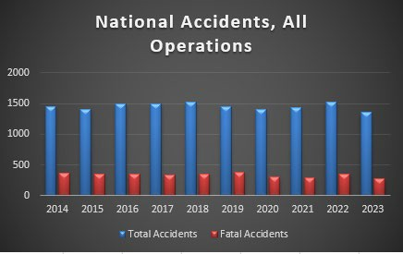
National Accident Information for FY2014-2023 with Fatality’s
Nationally there were 14440 accidents in the previous 10 year period, averaging 1444 per year.
In 2023 there was 1353 accidents, approximately a 11.5% decrease in accidents from 2022.

Slide 6
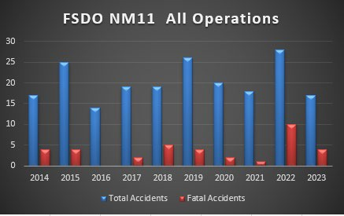
Boise FSDO Accident Information for FY 2014-2023 with Fatalities
There were 202 accidents for the 10-year period, averaging 20.1 accidents per year.
In FY2023, the Boise FSDO had 17 accidents, below the 10-year average.

Slide 7
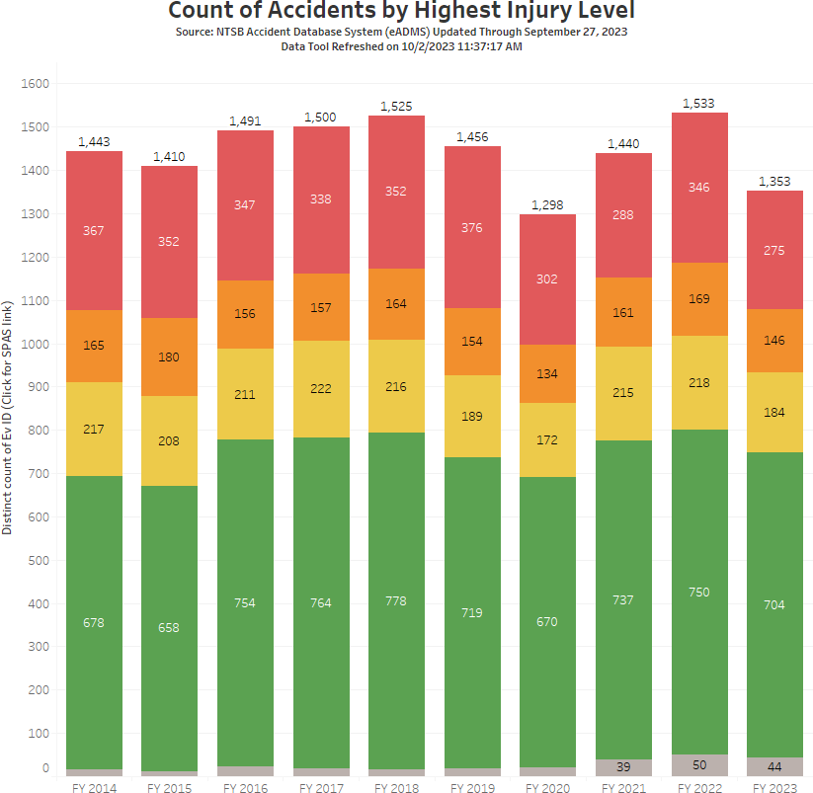
National Accident Information for FY2014-2023 with injury
Nationally both the number of fatal accidents and the number of fatalities has decreased slightly during the 10-year reporting period. FY2019 was the worst in the 10-year reporting period. The 10-year average is 309.5 fatalities per year with FY2023 having 275 fatalities. This is an 11% decrease over the 10 year average.

Slide 8
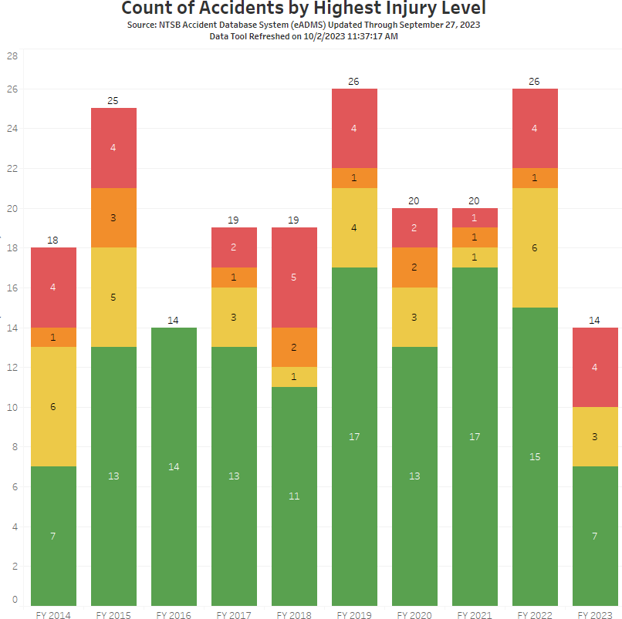
Boise FSDO Accident Information for FY2014-2023 with injury
Total Accidents=202 Total Fatal accidents = 30 Total Fatalities = 43
Both the number of fatal accidents and the number of fatalities has decreased slightly during the 10-year reporting period. FY2018 was the worst in the 10-year reporting period. The 10-year average is 4.3 fatalities with FY2023 being at five (5)

Slide 9
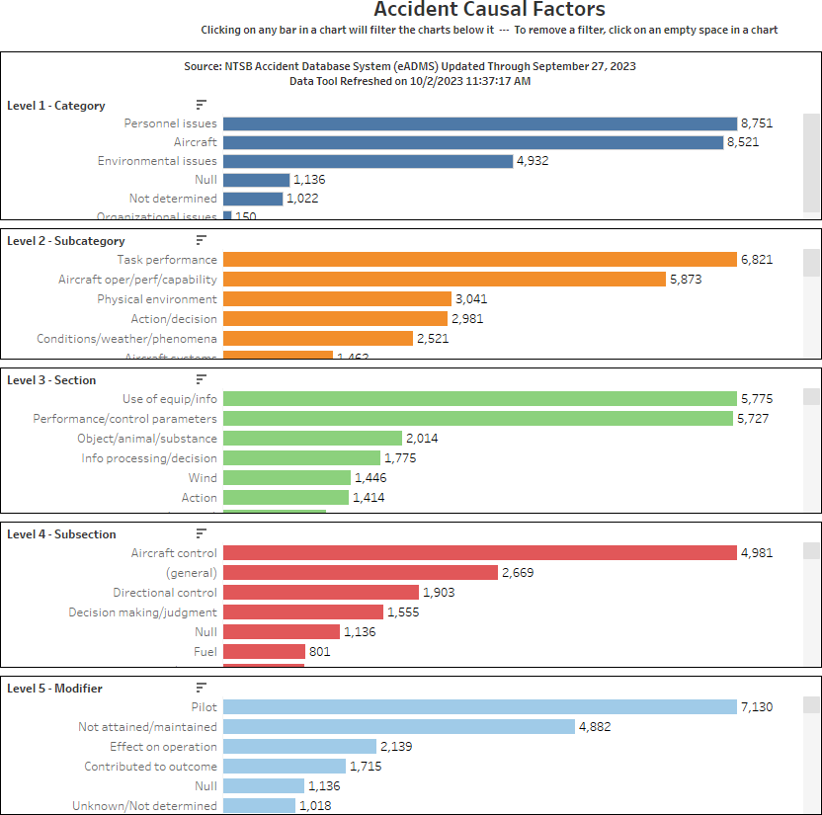
National Accident Information for FY2014-2023 Causal Factors
Page 1

Slide 10
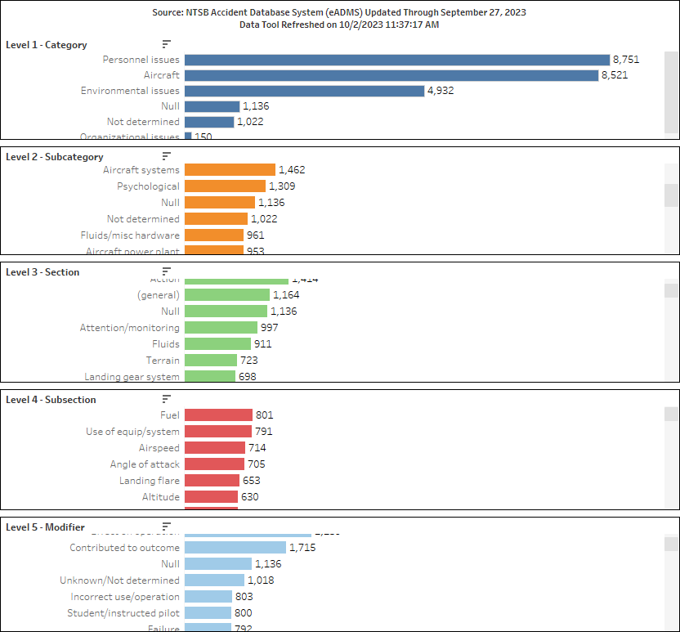
National Accident Information for FY2014-2023 Causal Factors
Page 2

Slide 11
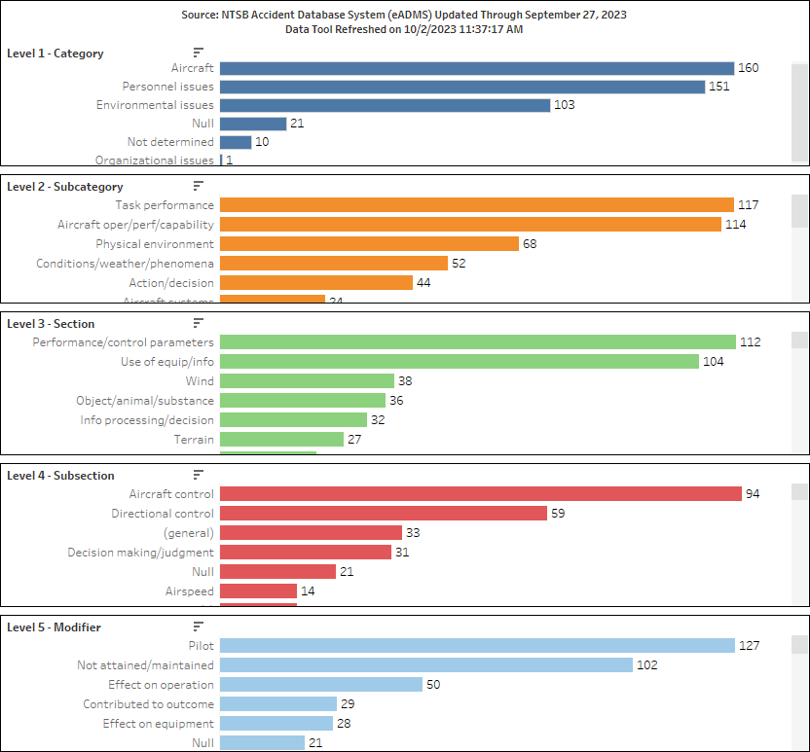
Boise Accident Information for FY2014-2023 Causal Factors
Page 1

Slide 12
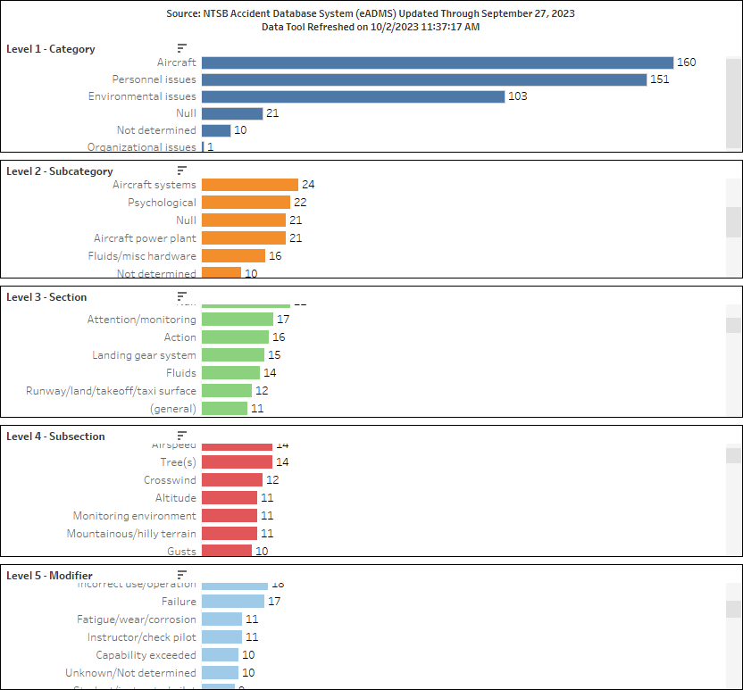
Boise Accident Information for FY2014-2023 Causal Factors
Page2
The areas of concern for the decade continue to be the Pilot Induced Errors resulting in Loss of Control (LOC), Controlled Flight into Terrain (CFIT), aircraft performance issues, and VMC into IMC.

Slide 13
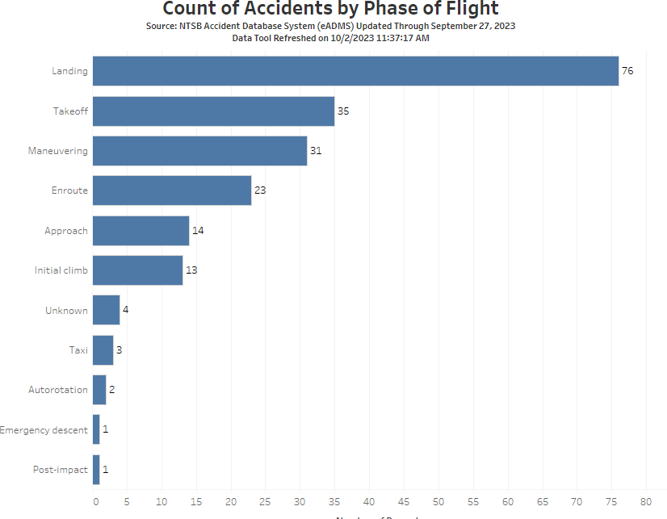
Boise FSDO Accident Information for FY2014-2023 phase of flight
As evidenced by the chart, landings are still the primary location of accidents

Slide 14
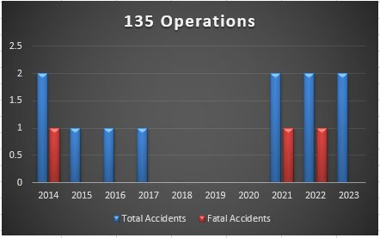
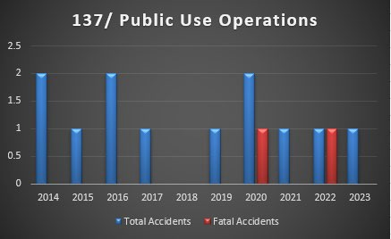
Boise 10 Year Accidents by operation (135)
No 135 operation accidents resulted in a fatality this year, accident rates remained the same.
Boise 10 Year Accidents by operation (137/ Public Use)
There were no 137/ Public Use fatalities this year.

Slide 15
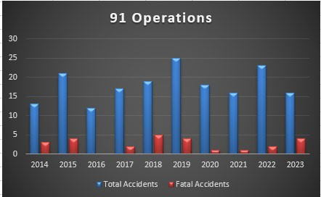
Boise 10 Year Accidents by operation (91)
Part 91 accidents continue to dominate the overall accident numbers.
Below is a further breakdown of the Part 91 accidents.

Slide 16
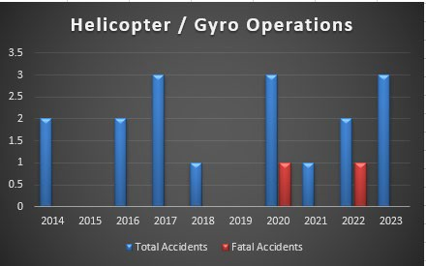
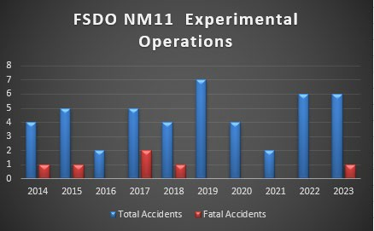
Accidents by A/C Type (Rotorwing)
There was a slight increase in rotorwing aircraft accidents in 2023. One was a training flight, one was a gyrocopter and one was pilot induced dynamic rollover. None were fatal or resulted in serious injuries.
Boise 10 Year Accidents by A/C Ceritification (experimental)

Slide 17
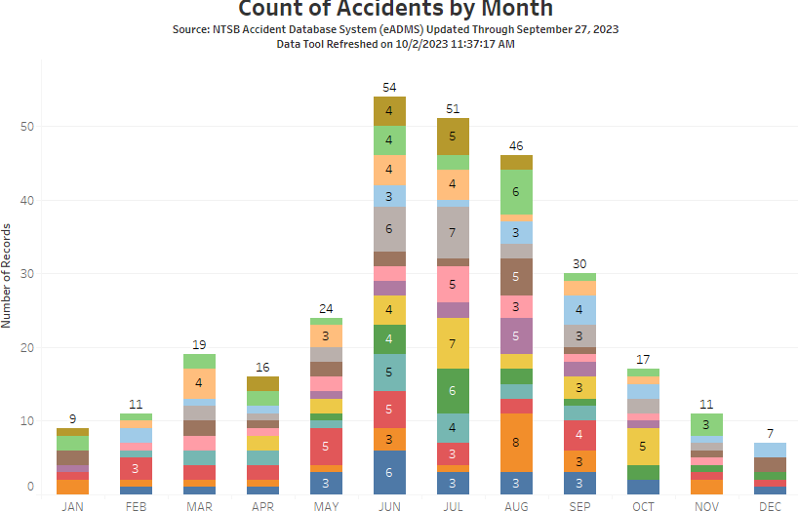
Experimental accidents remained the same as last year, unfortunately we had one fatality.
Experimental = 33% of total accidents and 25% of total fatal accidents this year.
Boise 10 Year Accidents by Month
This graph clearly illustrates the normal surge of accidents begining in spring and peaking in the summer, then tapering off through out the fall of the year.

Slide 18
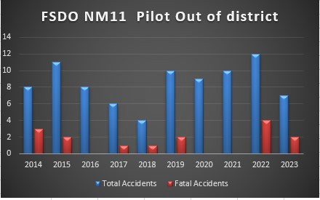
Boise 10 Year Accidents by pilot residence (out of district)
Almost 40% of our FY23 accidents were pilots out-of-district. Two of those accidents resulted in fatalities.

Slide 19
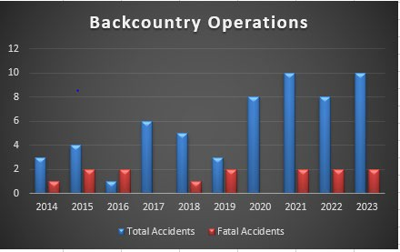
Backcountry flights are those operations into, or out of, non-hard surfaced airports/airstrips, conducted mostly in the central mountain area of Idaho. It could also include the desert areas around the district. (This data does not include operations that were intending to just overfly this terrain without intention to land.)
Touchdown/rollout/runup/ Takeoff accidents make up 54.5% of accidents.
Six of the thirteen TD/TO accidents were backcountry airstrips.
Nine of the eighteen accidents were out of district pilots.
Eight of thirteen TD/TO backcountry accidents were out of district pilots.

Slide 20
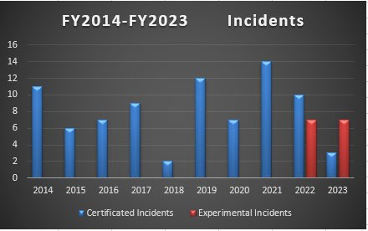
FY2014 – FY2023 Incidents
The trend indicates a downturn in incidents.
2 of 10 were TD/TO events.
2 were fuel management issues.
6 were mechanical issues with the aircraft.
3 were mechanical issues, 2 were vapor lock in experimental aircraft.

Slide 21
Hazard Identification, Risk Assessment, Mitigation Strategies
Hazards and Risks - General
The mix of aviation activities, in combination with transient flight operations, presents the potential for a variety of risks and challenges to the Boise FSDO District. The FSDO and FAASTeam work together to analyze appropriate data, identify hazards, assess risks and develop mitigation strategies, which ensure an acceptable level of safety both for airmen and the general public.
Hazard Area 1: Pilot Decision Making
Hazard Statement: Loss of Control (LOC), VFR flight into IMC and CFIT are often cited as the primary causal factor in many General Aviation fatal accidents. However, when applying a simple root cause analysis methodology, it can be shown that most of these fatal accidents resulted from poor Aeronautical Decision Making (ADM) before and/or during the fatal flight.
For the years 2014-2023 fatal LOC accidents have accounted for 51%, VFR into IMC have accounted for 20% and Mid-Air’s have accounted for 8% of the total fatal accidents in the Boise FSDO district.
Risk Assessment: Likelihood: Occasional Severity: Hazardous
The result of the above risk assessment is considered unacceptable and requires mitigation.
Mitigation Strategies: The audience may include flight schools, flying clubs, pilot and/or airport associations, EAA chapters, flight instructors, and DPEs.
Promotion of online courses on ADM and Risk Management (RM) via faasafety.gov.
Conduct or facilitate safety seminars with topics on ADM, RM and/or Human Factors.
Include discussion of ADM, RM, gear-up landings, fuel management and Human Factors during quarterly CFI Open Forums.
LOC specific events, with emphasis on Tail Wheel operations.
Weather education.
Metrics: Minimum, one presentation with topics of ADM, RM, and/or Human Factors. In each presentation, the FPM or Representative will promote faasafety.gov, the WINGS program, the AMT Awards program, and recommend the reporting of component failures through the Malfunction and Defect Reports or the Service Difficulty Report systems.

Slide 22
Hazard Area 2: Preflight Preparation
Hazard Statement: Failure to properly prepare for a flight is often a significant factor in the cause of accidents. Some of the more common failures are poor weather understanding, performance requirements, a lack of good communication between students and instructors.
In reviewing the accident causal factors, power loss, performance, system failures and weather have accounted for 17% of the total fatal accidents in the Boise FSDO district.
Risk Assessment: Likelihood: Occasional Severity: Hazardous
The result of the above risk assessment is considered unacceptable and requires mitigation.
Mitigation Strategies: The audience may include airmen from flight schools, flying clubs, pilot and/or airport associations, flight instructors, and DPEs.
Promotion of online courses on Preflight Planning, Performance and Pilot Risk Assessment via faasafety.gov.
Conduct or facilitate safety seminars with topics on Preflight preparation.
Include discussion of Pilot and Aircraft Preparation, Performance, Student & Instructor Communication, and Human Factors during quarterly CFI Open Forums.
Flight preparation specific events.
Weather education and weather briefing services.
Metrics: Minimum, one presentation with topics of Pilot and Aircraft Preparation, Aircraft Performance, and/or Human Factors. In each presentation, the FPM or Representative will promote faasafety.gov, the WINGS and the AMT programs.
Hazard Area 3: Experimental Amateur Built & Light Sport Aircraft Hazard Statement: The following are identified hazards ---
Airport location for aircraft construction, relative to 1st flight routing
Functional testing of the fuel system
Failure to develop and follow a Flight Test Plan prior to Phase 1 certification.
Confusion by builders relating to flight test hour requirements, which relate to the aircraft and not for pilot training/experience.
Failure to utilize accumulated flight test data to develop an AFM and emergency procedures
Purchasing used aircraft without an AFM
Certification issues (Weight & Balance, Documentation/Built Log, etc.)
Differences in the performance of maintenance between Light Sport Aircraft, Experimental Light Sport Aircraft, and Experimental Amateur Built Aircraft.
Utilizing a trained test pilot or acquiring test pilot training prior to flight test
Transition Training

Slide 23
For years 2014-2023 experimental aircraft (including EAB and ELSA) accidents have accounted for a significant percentage of the total accidents and fatal accidents in the Boise FSDO district.
Risk Assessment: Likelihood: Occasional Severity: Catastrophic
The result of the above risk assessment is considered unacceptable and requires mitigation.
Mitigation Strategies: The prime audience for risk mitigation is the Experimental Aircraft Association (EAA) chapters, which are scattered throughout the district. These chapters normally have scheduled monthly safety meetings where FAA/FAAST personnel may participate. The FAASTeam has developed PowerPoint presentations that address all the risks listed above. This provides briefings of the various hazards, as well as a question and answer sessions. Promotion of the WINGS Program and the faasafety.gov web site is also included.
In addition, FAA has implemented a policy to ensure an applicant has developed a formal Flight Test Plan prior to Phase 1 certification of an Experimental Amateur Built aircraft. After the assigned number of flight test hours are completed, the applicant will include data collected during the flight test, to develop an Aircraft Flight Manual and emergency procedures for the aircraft.
Metrics: Minimum, one presentation per year.
In the presentation the FPM or Representative will promote faasafety.gov, the WINGS program, the AMT Awards program, and recommend the reporting of component failures through the Malfunction and Defect Reports or the Service Difficulty Report systems.
Hazard Area 4: Backcountry Operations
Hazard Statement: The following are identified hazards - - -
Density altitude and lack of aircraft performance
Improper equipment for the location
Lack of pilot training & experience for the environment
Failure to fully assess the landing location
Weather information and assessment difficulties
Risk Assessment: Likelihood: Occasional Severity: Major
The result of the above risk assessment is considered unacceptable and requires mitigation.
Mitigation Strategies: The prime audience for risk mitigation are the participants attending the many Backcountry Fly-Ins which take place in the district each year. Mountain flying course are taught by Reps on a regular basis each spring and summer.

Slide 24
Metrics: Representatives, FPM and FSDO inspectors will support and attend most of the major fly-ins to provide outreach and guidance. In each outreach effort FPM or Representative will promote faasafety.gov, the WINGS program.
Other Mitigation Activities
The FAASTeam will also continue to promote safety and facilitate improvement to the Safety Culture in the following areas:
IA Renewal Training Support
Coordinate appropriate interface with various maintenance facilities including: Repair Stations, Part 135 Maintenance Facilities, Flight School Maintenance Departments, and Fixed Base Operators. Appropriate subjects include: Composites, Aging Aircraft, Failure to Follow Procedures/Instructions, Positive Safety Culture, and Personal Minimum Checklist.
Provide Owner Operator Maintenance presentations to EAA Chapters, flying clubs, and pilot organizations.
Support Runway Safety Meetings and Events
Facilitate safety briefings regarding Experimental Light Sport and Light Sport Aircraft.
Mitigation of Loss of Control (Approach/Landing) Presentations.
DPE Meetings and Outreach.
Single Pilot Resource Management Outreach.
Promote AMT Program Participation and Enrollment in FAASafety.gov.
Promote Charles Taylor “Master Mechanic” Award.
Promote General Aviation Airworthiness Awards.
Promote Wings and AMT Program Participation and Enrollment in FAASafety.gov.
Promote Wright Brothers Award.
Attend UAS seminars/webinars
Conduct First Responder Training with local Fire and Law Enforcement agencies.
Summary
For the Boise FSDO area of responsibility, the 2014 numbers dropped to 17, subsequently 2015 through 2022 have averaged 21.12 to reflect the overall trend. 2023 has shown a slight decrease. The fatal accidents did follow the same trend as the overall number of accidents for the same reporting period; they dropped. Part 91 tops the list for fatal accidents, with part 135 having no fatalities during the FY2023 reporting period. Out of district pilots remains high (about half) and hard to access for added training.
This analysis has led to 4 Hazard Areas identified in this report. The Metrics that were created help in accomplishing the requirements of the National FAASTeam business plan.

Slide 25
Appendix 1: Risk Matrix
Risk
Risk Severity
Likelihood
Catastrophic A
Hazardous B
Major
C Minor D
Negligible E
Frequent 5
5A
5B
5C
5D
5E
Occasional 4
4A
4B
4C
4D
4E
Remote
3
3A
3B
3C
3D
3E
Improbable 2
Extremely Improbable
2A
2B
2C
2D
2E
1
1A
1B
1C
1D
1E

Slide 26
Appendix 2: Fatal Accidents
Fatal Accidents FY2014 - FY2023
Total | Date | Reg. No. | FAR | Make. Model | Fatalities | Location
1 | 11/6/2013 | N206KL | 135 | Cessna U206F | 3 | Donnelly, ID
2 | 12/1/213 | N36ML | 91 | Beech B36TC | 5 | McCall, ID
3 | 7/7/2014 | N7390K | 91 | Cessna R172K | 1 | Landmark, ID
4 | 10/3/2014 | N51TG | 91 | Thunder Mustang (EXP) | 1 | Council, ID
5 | 4/10/2015 | N732YQ | 91 | Cessna 210M | 4 | Challis, ID
6 | 5/14/2015 | N5042P | 91 | Citrabra 7GCBC | 1 | Juntura, OR
7 | 7/2/2015 | N8195C | 91 | PA-22-135 | 1 | Carey, ID
8 | 6/17/2017 | N177TT | 91 | RV-3 | 1 | Payette, ID
9 | 9/2/2017 | N65EW | 91 | Glasstar sportsman (EXP) | 1 | Sulphur Creek, ID
10 | 5/13/2018 | N2377R | 91 | Cessna 182 | 1 | Smiths Ferry, ID
11 | 6/2/2018 | N63073 | 91 | Glider (airshow) | 1 | Mountain Home, ID
12 | 8/11/2018 | N231EC | 91 | Mooney M20K1 | 2 | Baker City, OR
13 | 9/30/2018 | N732MV | 91 | Cessna 210M | 3 | Silver City, ID
14 | 5/19/2019 | N1888D | 91 | Beech BE35 | 1 | Murphy, ID
15 | 6/5/2019 | N4362V | 91 | Titan II (EXP) | 1 | Summerville, OR
16 | 7/17/2019 | N112AJ | 91 | B1 Glider | 1 | Wildhorse Valley, OR
17 | 8/9/2019 | N9862C | 91 | T-28 | 1 | Ontario, OR
18 | 9/10/2019 | N6300Z | 91 | PA-32 | 1 | LaGrande, OR
19 | 10/25/2019 | N280F | 91 | Enstrom 280F | 1 | Jordan Valley, OR
20 | 09/22/2020 | N836MM | 91 | AT-802A | 1 | Emmett, ID
21 | 08/28/2021 | N922MA | 135 | CE-206 | 2 | Bernard AS, ID
22 | 04/31/2022 | N928JP | 135 | CE-208 | 1 | Burley, ID
23 | 07/21/2022 | N388RA | PU | CH-47 | 2 | North Fork, ID
24 | 08/15/2022 | N26HV | 91 | Aviat Husky | 2 | Johnson Creek, ID
25 | 04/02/2023 | NXXXXX | 91 | Cirrus SR-22 | 2 | Oxbow, OR
26 | 06/12/2023 | NXXXXX | 91 | CE-R182 | 1 | McCall, ID
27 | 07/30/2023 | NXXXXX | 91 | T206H | 1 | Cabin Creek, ID
28 | 08/04/2023 | NXXXXX | 91 | Glassair (EXP) | 1 | Idaho City, ID

Slide 27
FY23 Accidents
Appendix 3: Accident/Incident Data
 | Date | N# | M/M | Helo | POF | Dirt/Grass | Cat | Persons OB | Injury
1 | 1/16/2023 | NXXXXX | Maule MX-7 |  | Landing | Snow |  | 1
2 | 4/2/2023 | NXXXXX | Cirrus SR-22 |  | Cruise |  |  | 2 | 2 Fatal
3 | 4/25/2023 | NXXXXX | Cessna 140 |  | Takeoff | Y |  | 1 | 1 Minor
4 | 6/3/2023 | NXXXXX | Rockwell S-2R |  | Takeoff | Y |  | 1
5 | 6/3/2023 | NXXXXX | Bell 205B | Y | Hover |  |  | 1 | 1 Minor
6 | 6/9/2023 | NXXXXX | Calidus | Y | Landing |  | Exp | 1
8 | 6/28/2023 | NXXXXX | Carbon Cub |  | Landing | Y | Exp | 1
9 | 7/3/2023 | NXXXXX | Piper PA-18 |  | Landing |  |  | 1
10 | 7/8/2023 | NXXXXX | Robinson R-22 | Y | Autorotation | Y |  | 2
11 | 7/8/2023 | NXXXXX | AT-6G |  | Low approach/Climb Out | Y |  | 2
12 | 7/29/2023 | NXXXXX | Cruiser |  | Low approach/Climb Out | Y | Exp | 2
13 | 7/30/2023 | NXXXXX | T-206H |  | Maneuvering | Y |  | 1 | 1 Fatal
14 | 8/3/2023 | NXXXXX | Cozy EZ |  | Cruise/ Forced landing | Y | Exp | 1 | 1 Minor
15 | 8/4/2023 | NXXXXX | Glasair |  | Takeoff | Y | Exp | 1 | 1 Fatal
16 | 8/5/2023 | NXXXXX | T210M |  | Forced Landing / fuel issue | Y |  | 4
17 | 9/20/2023 | NXXXXX | U206C |  | Failed landing gear | Y |  | 4

Slide 28
FY23 Incidents
 | Date | N# | M/M | Helo | POF | Dirt/Grass | Cat | Persons OB | Injury
1 | 1/2/2023 | NXXXXX | 421C |  | T/O / Propeller |  |  | 4
2 | 1/23/2023 | NXXXXX | Van’s RV-12 |  | Takeoff/ VL |  | Exp | 2
3 | 2/21/2023 | CXXXXXX | Piper PA-42 |  | Touchdown / Nose gear |  |  | 1
4 | 4/29/2023 | NXXXXX | Vans RV-12 |  | Takeoff /VL |  | Exp | 2
5 | 5/27/2023 | NXXXXX | Maule M-6 |  | Rollout / Mud | Y |  | 2
6 | 5/27/2023 | NXXXXX | Vans RV-12 |  | Touchdown / porp |  | Exp | 1
7 | 7/7/2023 | NXXXXX | L-39 |  | Rollout / hyd failure |  | Exp | 1
8 | 8/1/2023 | NXXXXX | Glastar |  | Cruise / fuel |  | Exp | 2
9 | 8/13/2023 | NXXXXX | Kodiak |  | Offloading / tail | Y |  | 4
10 | 9/22/2023 | NXXXX | Jabiru J250 |  | Landing / short |  | Exp | 2
11 | 9/25/2023 | NXXXXX | Vans RV-12 |  | Touchdown porp |  | Exp | 1

